Slide 1

ANALYSIS OF CBC FLUCTUATIONS
Under the Guidance of
Mr. Suresh Shetty
Associate Professor
Department of Mechanical Engineering
Department of Mechanical Engineering
Ankush M Rao
Pranav Baliga
Shetty Shobit Gunesh
Dhanraj
4NM17ME022
4NM17ME029
4NM17ME167
4NM17ME045

Slide 2
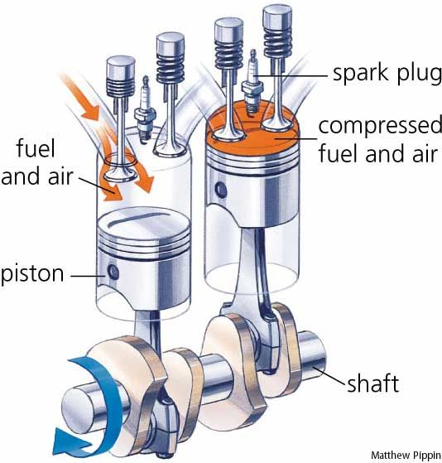
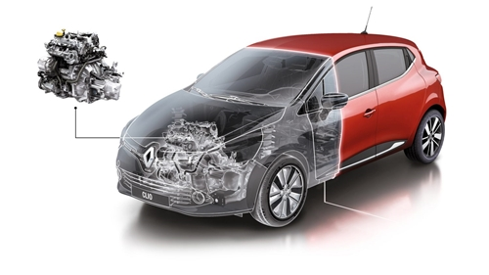
Abstract
Combustion engines are primary mode of transportation using fossil fuel which are being replaced by alternative fuels.
This presentation is aimed at understanding the cycle by cycle variations in an SI engine for different conditions.
Introduction to SI engines and Ethanol, along with literature review, objectives and method of approach will be discussed.

Slide 3
Introduction
A four-stroke engine is an internal combustion engine in which the piston completes four separate strokes.
The combustion process is not repetitive from cycle to cycle. This can be found out easily if we trace the pressure in the cylinder.
IMEP(Mean Effective Pressure) Vs Number of cycles.

Slide 4
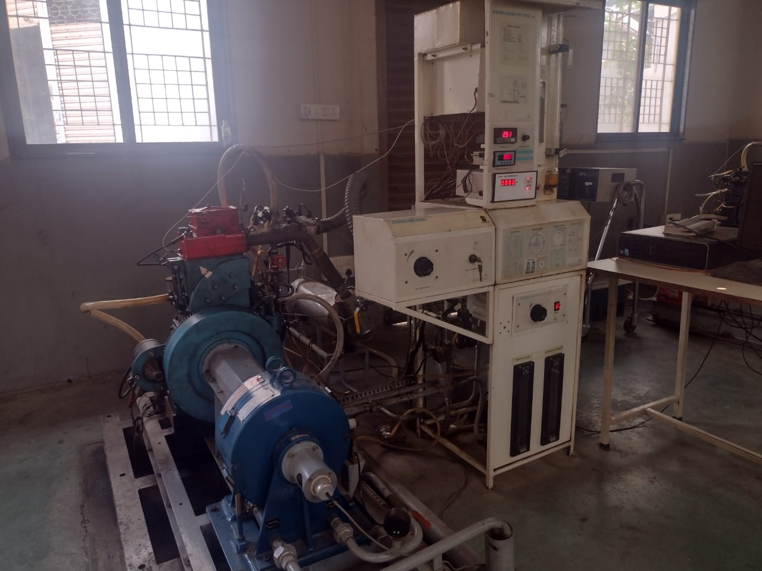
Introduction
Ethanol or Ethyl Alcohol is an alternative fuel, produced from biomass.
Petrol or Gasoline is a fossil fuel obtained by fractional distillation of petroleum.
Pure petrol, E5, E10, E15 and E20 are the ratios to be used for this project.

Slide 5
Literature Review
The use of ethanol-gasoline blend as a fuel in SI engine; Fikret Yu¨ksel And Bedri Yu¨ksel.
Investigation into SI engine performance, characteristics and emission fueled with Ethanol/Butanol-Gasoline blends; M. Mourad a, K. Mahmoud
The effects of Ethanol–unleaded Gasoline blends and ignition timing on engine performance and exhaust emissions; Tolga Topgu¨l, Hu¨seyin Serdar Yu¨cesu, Can C- inar, Atilla Koca

Slide 6
Literature Review
Experimental determination of suitable ethanol–gasoline blend rate at high compression ratio for gasoline engine; M. Bahattin Celik
Engine performance and pollutant emission of an SI engine using ethanol–gasoline blended fuels; Wei-Dong Hsieha, Rong-Hong Chenb, Tsung-Lin Wub, Ta-Hui Lina

Slide 7
Objectives
To find the cycle by cycle fluctuations of a 4-stroke spark ignition engine with petrol-ethanol blend of various ratios.
This study helps to get the idea of what ratio of blends has to be used to reduce the CBC fluctuations and emissions in SI engine and to increase the efficiency.
Parameters to be found includes: IMEP and coefficient of variation
Graphical representation indicating the performance parameters are plotted for all the blends.

Slide 8
Methodology
A single cylinder 4 stroke water-cooled petrol engine with a rated power of 4.50 kilowatt at a speed of 1800 RPM was used.
The experimentations were done using a computerised rig and by using a software IC Engine Soft Data for analysis.
Cycle by cycle fluctuation is found by testing the performance of the petrol engine for different percent of ethanol and petrol blend.

Slide 9
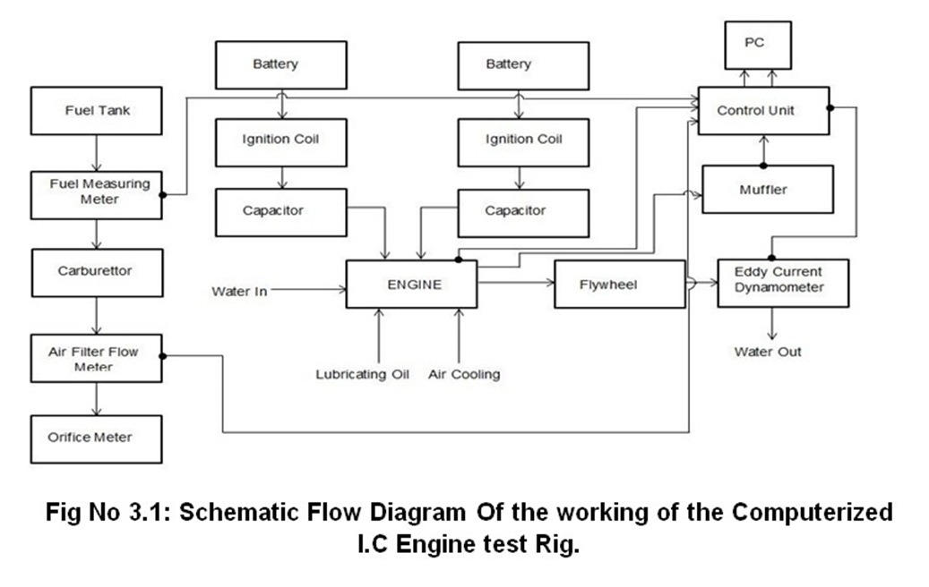

Slide 10
Results And Discussions
The fluctuations of IMEP for 200 cycles at 1800rpm for various compression ratios and spark timings at different loads have been recorded using engine analysis software.
COV shows the extent of variability in relation to the mean of the population.
COV is defined as the ratio of standard deviation to the mean.
COV = (√((∑_(i=1)^n▒(¯X-Xi)^2 )/¯n)/¯X) where , ¯X= (∑_(i=1)^n▒Xi)/n
Numerous graphs have been plotted by taking COV on y axis and Petrol blends (Ethanol% ), Spark timing and Compression Ratio on x axis with varying loads.

Slide 11
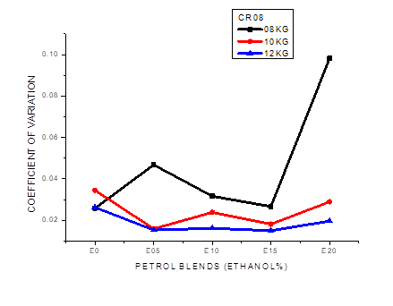
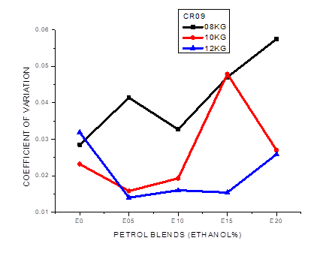
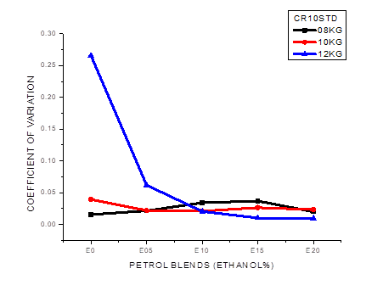
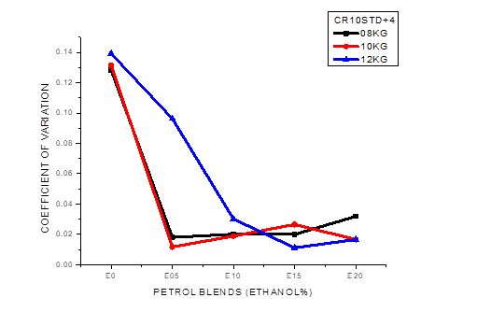
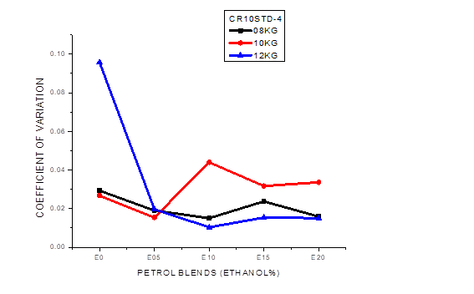

Slide 12
Conclusion
From all the above observations with varying Loads (08,10,12kg), Compression Ratios (08,09,10) and Spark Timings(-4, STD, +4) for all 5 blends (E0,E5,E10,E15,E20) it is clear that,
Best Compression Ratio=10
Best Spark Timing=STD
Best load=12 kg
That implies, 10STD_12kg is the best condition.
Under this condition with 5 different blends it was clearly observed that blend E20 displays the least variation.

Slide 13
Reference
Yüksel, F. and Yüksel, B., 2004. The use of ethanol–gasoline blend as a fuel in an SI engine. Renewable energy, 29(7), pp.1181-1191.
Mourad, M. and Mahmoud, K., 2019. Investigation into SI engine performance characteristics and emissions fuelled with ethanol/butanol-gasoline blends. Renewable Energy, 143, pp.762-771.
Topgül, T., Yücesu, H.S., Cinar, C. and Koca, A., 2006. The effects of ethanol–unleaded gasoline blends and ignition timing on engine performance and exhaust emissions. Renewable energy, 31(15), pp.2534-2542.
Celik, M.B., 2008. Experimental determination of suitable ethanol–gasoline blend rate at high compression ratio for gasoline engine. Applied Thermal Engineering, 28(5-6), pp.396-404.
Hsieh, W.D., Chen, R.H., Wu, T.L. and Lin, T.H., 2002. Engine performance and pollutant emission of an SI engine using ethanol–gasoline blended fuels. Atmospheric Environment, 36(3), pp.403-410.

Slide 14


